Slide 1
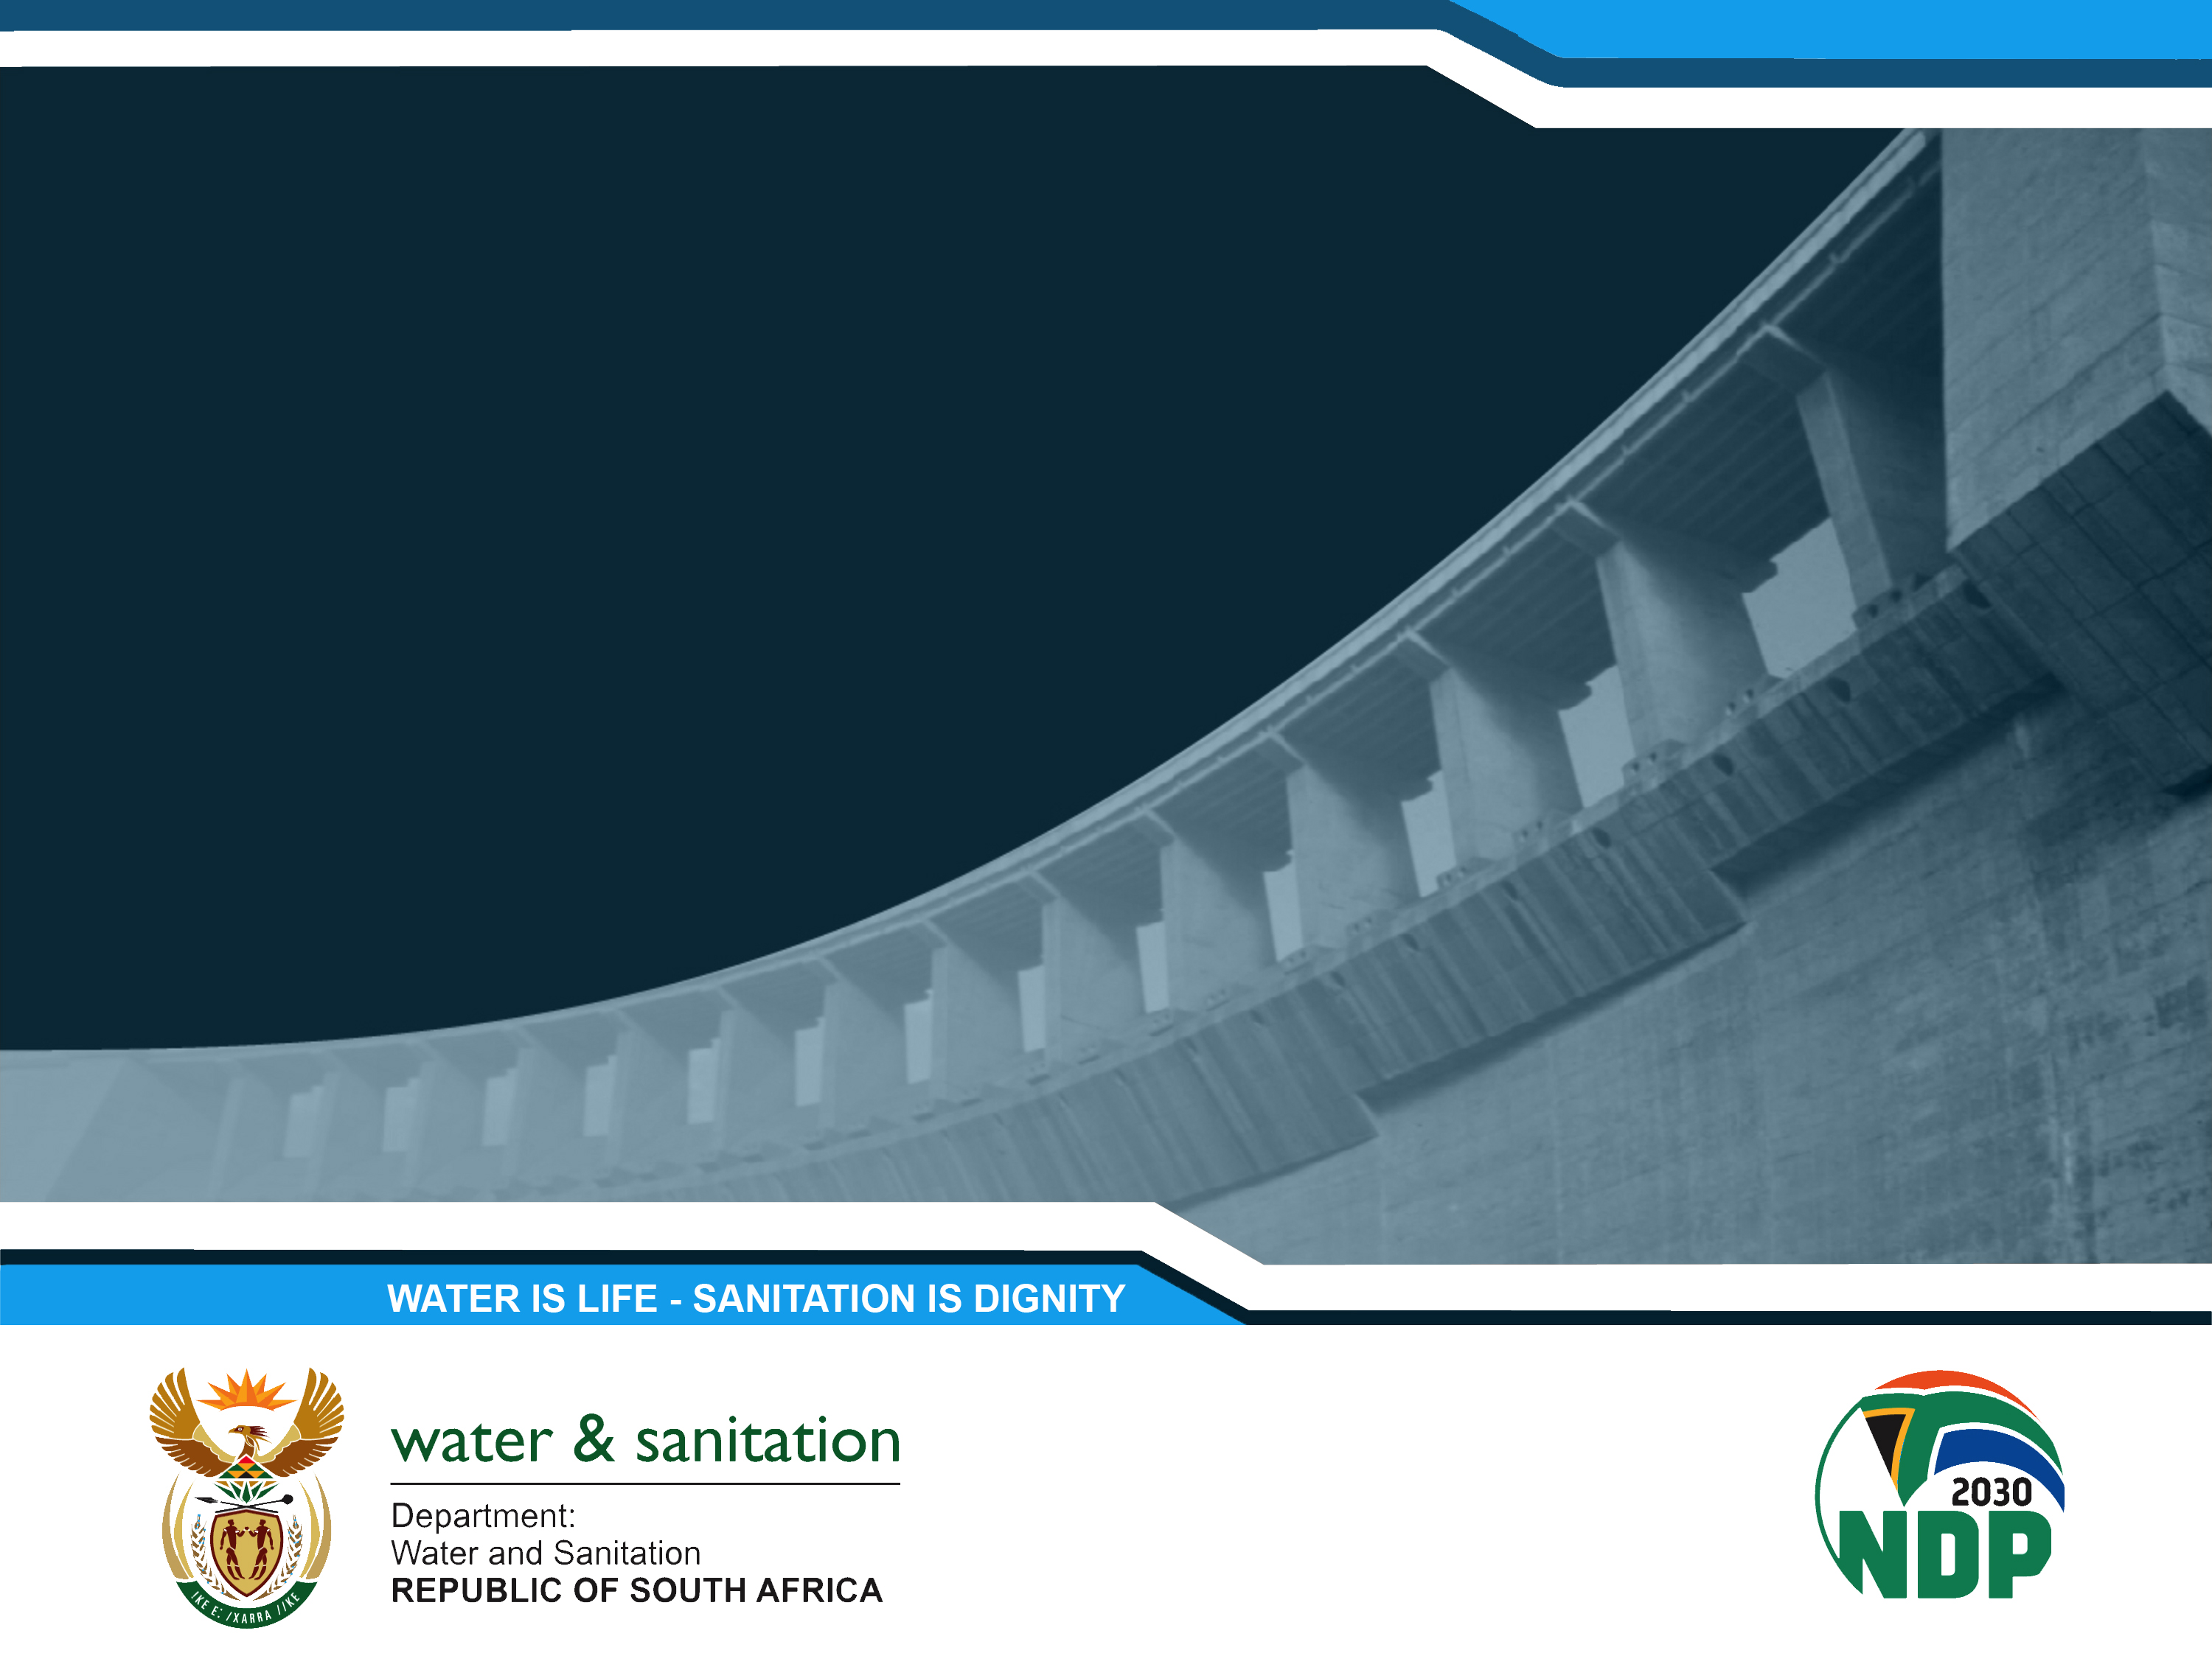
Water Services Drop Programmes
2023 Reports
PRESENTATION TITLE
Presented by: Name Surname
Designation: Director
Directorate: Communication Services
Date: 15 April 2019
Presented by: Dr S Phillips
Designation: Director-General
5 December 2023
Drinking Water (Blue Drop)
Wastewater (Green Drop)
Water Conservation and Demand Management (No Drop)

Slide 2

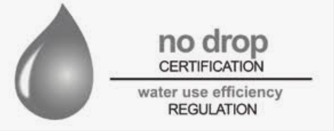
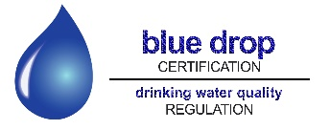
Introduction to the Drop Programmes
The Green, Blue and No Drop Certification programmes are tools to provide regulatory information regarding water services, which are largely the Constitutional responsibility of municipalities
DWS introduced these incentive-based regulation programmes in 2008
In 2014 DWS stopped the programmes
Minister Mchunu reintroduced the programmes in 2022 after being appointed as Minister in late 2021

Slide 3
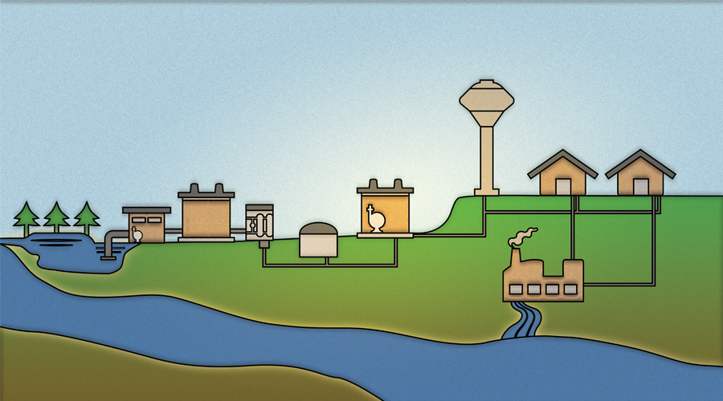
The domestic water cycle
Water for domestic use goes through a cycle.
Raw water is drawn from rivers and dams and treated in Water Treatment Works by either water boards or municipalities before it is supplied to households.
Treated water is required by law to meet drinking water standards set by the South African Bureau of Standards in South African National Standard (SANS) 241. Municipalities and water boards are also required to conduct regular tests on the treated water to ensure that it complies with the standard.
3. After the water has been used by households, it goes through the sewer system to municipal wastewater treatment works. The wastewater treatment works remove waste from the water and then return the water to the rivers. The effluent from wastewater treatment works which goes into rivers is also required to meet minimum standards, set by the Department of Water and Sanitation.

Slide 4
What the Blue and Green Drop reports focus on
The Green Drop report is a comprehensive assessment of the state of all wastewater treatment systems in South Africa, including municipal, Department of Public Works and private wastewater treatment systems
The Blue Drop report is a similar assessment of the state of all drinking water systems (including Water Treatment Works and municipal water distribution systems) in the country
Both reports cover:
  assessments of the condition of the infrastructure
  whether the required maintenance is being done on the infrastructure
  whether the infrastructure is operated correctly
  whether the proper treatment processes are followed
  whether proper monitoring and controls are in place
  whether the staff have the necessary skills and qualifications

Slide 5
What the No Drop report focuses on
The No Drop report is an assessment of the degree to which the drinking water distribution systems of municipalities supply water efficiently, without wasting water
The No Drop assessment covers:
  levels of physical water losses in the system (for example through leaks in pipes)
  levels of non-revenue water
  the average amount of water used per capita per day
  whether infrastructure is being maintained properly to minimise wastage
  the existence of plans and strategies to reduce water losses; the effectiveness of metering, billing and revenue collection systems

Slide 6
Purpose of the Drop reports
The aim of this uniquely South African regulatory tool is to improve municipal drinking water quality, wastewater management as well as water conservation and demand management
The reports keep the public and stakeholders informed and updated with credible data and information about the state of water and sanitation services in the country
The reports also recognise water services institutions that achieve compliance and excellence in providing such services. This serves as an incentive for water services institutions to improve their performance
The reports identify what needs to be done to address each of the shortcomings identified in the reports
  In this regard, the reports are a support mechanism, in addition to being a regulatory mechanism, because they provide the owners of the infrastructure with advice and guidance as to how to improve their water and sanitation services

Slide 7
Publication of the reports
Each full or comprehensive drop report is released every two years, with progress assessment reports in alternate years
The Progress Assessment Tool is a risk assessment for each registered treatment works
The full Green Drop was released in 2022, along with Blue Drop progress assessment report
Today the full Blue Drop and the full No Drop reports are being released, along with the Green Drop progress assessment report
The full Blue Drop and Green Drop reports measure and compare the performance of Water Service Institutions, and subsequently rewards (or penalises) the institution based on evidence of excellence (or failures) when measured against the defined standards
The full Blue Drop and Green Drop reports cover the entire system including the distribution or collection network, pumpstations and treatment works for either water or wastewater
The full No Drop report provides an assessment of water losses and non-revenue water in all municipalities in the country

Slide 8
Publication of the reports: graphic
Drop Regulations Programme
Incentive-based regulation
Risk-based regulation
Critical Risk Rating (CRR)
Drop assessment against KPAs
Compliance against set criteria which includes risk-management
Assessment of key critical risk areas
Measures the performance and subsequently rewards (or penalises) Water Service Institutions’ performance
Allows Water Services Institutions to identify, quantify and manage the risks
Full report
Progress Assessment Report

Slide 9
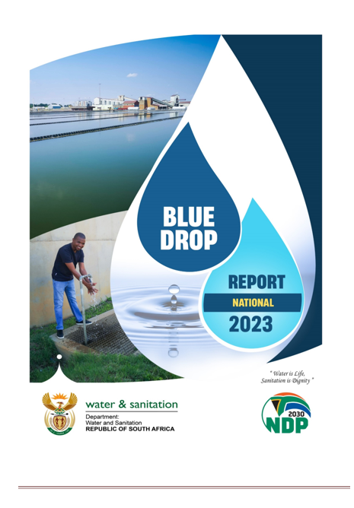
Blue Drop 2023 Report
Audit year: 1 Jul 2021- 30 Jun 2022
This presentation covers key findings of the 2023 Blue Drop Assessment. The full reports provide more detailed and additional information. The national report and detailed provincial reports are available for download from www.dws.gov.za

Slide 10
2022-23 Blue Drop assessment process
All 144 water services authorities (WSAs, i.e. municipalities given the responsibility for water services provision by the Minister of COGTA) were audited during the period 1 July 2021- 30 June 2022
These WSAs own and operate 958 Water Supply Systems (WSS) (each water services authority is responsible for several different water supply systems)
Most municipalities are provided with bulk water services by the water boards which were also audited
Each WSA and water board was requested to provide information on their performance against all the Blue Drop criteria
All the WSAs and water boards were trained on the criteria and the audit process to be followed and were requested to submit information
DWS then carried out on-site assessments to verify the information provided
Sessions were then organised with all the WSAs and water boards to clarify any anomalies found
Finally, sessions were held with all the WSAs and water boards to give feedback on the results and to indicate what the municipalities and or water boards need to do to improve their performance

Slide 11
2022-23 Blue Drop audit coverage
Province | # Water Services Authorities | # Water Supply Systems | # Water Treatment Works
Eastern Cape (EC) | 14 | 154 | 222
Free State (FS) | 19 | 80 | 75
Gauteng (GP) | 9 | 29 | 19
KwaZulu Natal (KZN) | 14 | 172 | 190
Limpopo (LP) | 10 | 84 | 85
Mpumalanga (MP) | 17 | 100 | 107
Northern Cape (NC) | 26 | 176 | 158
North West (NW) | 10 | 39 | 33
Western Cape (WC) | 25 | 124 | 126
Totals | 144 | 958 | 1,015
SANParks (DFFE) in Mpumalanga | 1 | 13 | 13
Totals |  | 971 | 1,028
Note: Water supply systems include both water board and municipal water supply systems.

Slide 12
2023 Blue Drop: Key Performance Areas summary
KPA and sub-KPAs | Sub-weight
KPA 1: CAPACITY MANAGEMENT | 15%
1.a) Registration of Water Treatment Plant | 20%
1.b) Registration of Process Controllers and Supervisor | 20%
1.c) Maintenance Capacity | 20%
1.d) Engineering Management Capacity | 20%
1.e) Scientific Capacity | 20%
KPA 2: DRINKING WATER QUALITY RISK MANAGEMENT | 20%
2.a) Water Safety Planning | 40%
2.b) Operational Monitoring | 10%
2.c) Compliance Monitoring | 20%
2.d) Laboratory Credibility | 20%
2.e) Incident Management Protocol | 10%
KPA 3: FINANCIAL MANAGEMENT | 15%
Water Treatment Operations and Maintenance Cost Determination done:
i) Determined for the whole Water Supply System; or
ii) Determined for part of the system; or
iii) Not system specific (Global only); or
iv) Not Done at all
3.a) Water Supply Operations Cost Determination | 35%
3.b) Water Supply Operations & Maintenance Budget | 10%
3.c) Water Supply Operations & Maintenance Expenditure | 25%
3.d) Supply Chain Management of Services and Treatment Products | 20%
3.e) Capital Budget and Expenditure | 10%
KPA and sub-KPAs (contd) | Sub-weight
KPA 4: TECHNICAL MANAGEMENT | 15%
4.a) WTW Design and Supply Capacity Management | 20%
4.b) Process Audit | 30%
4.c) Water Reticulation Inspection | 25%
4.d) Water Treatment and Supply system Asset Management | 25%
KPA 5: DRINKING WATER COMPLIANCE | 35%
5.a) Monitoring Data Submission to DWS | 10%
5.b) Acute Health Microbiological Risk Compliance | 30%
5.c) Chemical Compliance | 20%
5.d) Risk Defined Compliance | 15%
5.e) Treatment (Operational) Efficiency Index | 5%
BONUSES
6.a) Process Control Training | 25%
6.b) Performance Agreements | 25%
6.c) Publication of Drinking Water Quality Results | 25%
6.d) Water Demand Management | 25%
PENALTIES
7.a) Data variances and Discrepancies | 50%
7.b) Non-notification of DWQ Failure | 50%

Slide 13
2023 Blue Drop score categorisation
The Blue Drop Scores for each water supply system are categorised as follows:
 | >95-100% | Excellent situation, need to maintain via continued improvement
 | >80-<95% | Good performance, some room for improvement
 | >50-<80% | Average performance, ample room for improvement
 | >31-<50% | Poor performance, need targeted intervention towards gradual sustainable improvement
 | 0-<31% | Critical state, need urgent intervention for all aspects of the water services business
This categorization system is applied to the aggregated score for each water supply system and for each water services authority.

Slide 14
2023 Blue Drop scores by province
 | No (%) of systems per Blue Drop score category 2014 | No (%) of systems per Blue Drop score category 2014 |  |  |  |  | No (%) of systems per Blue Drop score category 2023 | No (%) of systems per Blue Drop score category 2023
Province | Total no systems | 95–100 Excellent | 80-<95 Good | 50-80 Average | 31-50 Poor | 0-31 Critical | Total no systems | 95–100 Excellent | 80-<95 Good | 50-80 Average | 31-50 Poor | 0-31 Critical
EC | 155 | 0 (0%) | 39 (25%) | 53 (34%) | 32 (20%) | 31 (20%) | 154 | 0 (0%) | 6 (4%) | 88 (57%) | 33 (21%) | 27 (18%)
FS | 79 | 6 (8%) | 7 (9%) | 41 (52%) | 20 (25%) | 5 (6%) | 80 | 0 (0%) | 2 (3%) | 31 (39%) | 16 (20%) | 31 (39%)
GP | 29 | 9 (31%) | 17 (59%) | 3 (10%) | 0 (0%) | 0 (0%) | 29 | 3 (10%) | 15 (52%) | 8 (28%) | 3 (10%) | 0 (0%)
KZN | 209 | 8 (4%) | 16 (8%) | 124 (59%) | 43 (21%) | 18 (9%) | 172 | 3 (2%) | 19 (11%) | 95 (55%) | 34 (20%) | 21 (12%)
LP | 74 | 1 (1%) | 9 (12%) | 19 (26%) | 23 (31%) | 22 (30%) | 84 | 0 (0%) | 0 (0%) | 44 (52%) | 14 (17%) | 26 (31%)
MP | 100 | 9 (9%) | 7 (7%) | 33 (33%) | 28 (28%) | 23 (23%) | 100 | 4 (4%) | 9 (9%) | 42 (42%) | 11 (11%) | 34 (34%)
NC | 173 | 2 (1%) | 13 (8%) | 76 (44%) | 48 (28%) | 34 (20%) | 176 | 0 (0%) | 5 (3%) | 18 (10%) | 30 (17%) | 123 (70%)
NW | 95 | 1 (1%) | 2 (2%) | 34 (36%) | 26 (27%) | 32 (34%) | 39 | 1 (3%) | 5 (13%) | 13 (33%) | 13 (33%) | 7 (18%)
WC | 122 | 8 (7%) | 19 (16%) | 61 (50%) | 25 (20%) | 9 (7%) | 124 | 15 (12%) | 47 (38%) | 34 (27%) | 20 (16%) | 8 (6%)
Totals | 1036 | 44 (4%) | 129 (12%) | 444 (43%) | 245 (24%) | 174 (17%) | 958 | 26 (3%) | 108 (11%) | 373 (39%) | 174 (18%) | 277 (29%)
The number of water supply systems in 2023 is slightly lower of that assessed in 2014 because some municipalities have merged some of their systems and some boreholes which were assessed in 2014 were not assessed in 2023.

Slide 15
2023 Blue Drop: key findings
26 water supply systems (WSSs) scored more than 95% and qualified for the prestigious Blue Drop Certification. In 2014, 44 WSSs were awarded Blue Drop status
  An overall decline in excellence is noted between 2014 and 2023
277 of 958 (29%) WSSs (in 62 WSAs - see Annexure A) were identified to be in a critical state of performance compared with 174 WSSs (in 33 WSAs) in 2014
  An overall increase in the number of systems in a critical state of performance is noted between 2014 and 2023
Drinking water systems in the major metropolitan areas are generally performing well in terms of the Blue Drop key performance areas
Gauteng has the highest percentage of drinking water systems with excellent or good performance (62%), followed by Western Cape (50%)*
Northern Cape has the highest percentage of drinking water systems with poor or critical performance (87%). This has deteriorated from 48% in 2014
The percentage of drinking water systems with poor or critical performance in Free State has also deteriorated markedly from 2014 (31%) to 2023 (59%)
* Notes:
The water supply disruptions which have been experienced in Gauteng in recent months are caused by the demand for treated water occasionally exceeding the available supply of treated water
One of the reasons for the good performance of systems in Gauteng is the fact that Rand Water manages the treatment of water and distribution elements of many of the systems in Gauteng

Slide 16
2023 Blue Drop: critically performing systems
Province | 2014 WSSs in a critical state of performance (<31%) | 2023 WSSs in a critical state of performance (<31%) | 2023 WSAs with systems in a critical state of performance
Eastern Cape | 31 | 27 | 5
Free State | 5 | 31 | 9
Gauteng | None | None | None
KwaZulu Natal | 18 | 21 | 4
Limpopo | 22 | 26
Mpumalanga | 23 | 34 | 8
Northern Cape | 34 | 123 | 22
North West | 32 | 7 | 3
Western Cape | 9 | 8 | 4
Totals | 174 | 277 | 61

Slide 17
2023 Blue Drop analysis: pie charts
2014 Blue Drop Assessment Results (water supply systems)
2023 Blue Drop Assessment Results (water supply systems)
>95 – 100% Excellent
>80-<95% Good
>50-<80% Average
31-<50% Poor
0-<31% Critical state

Slide 18
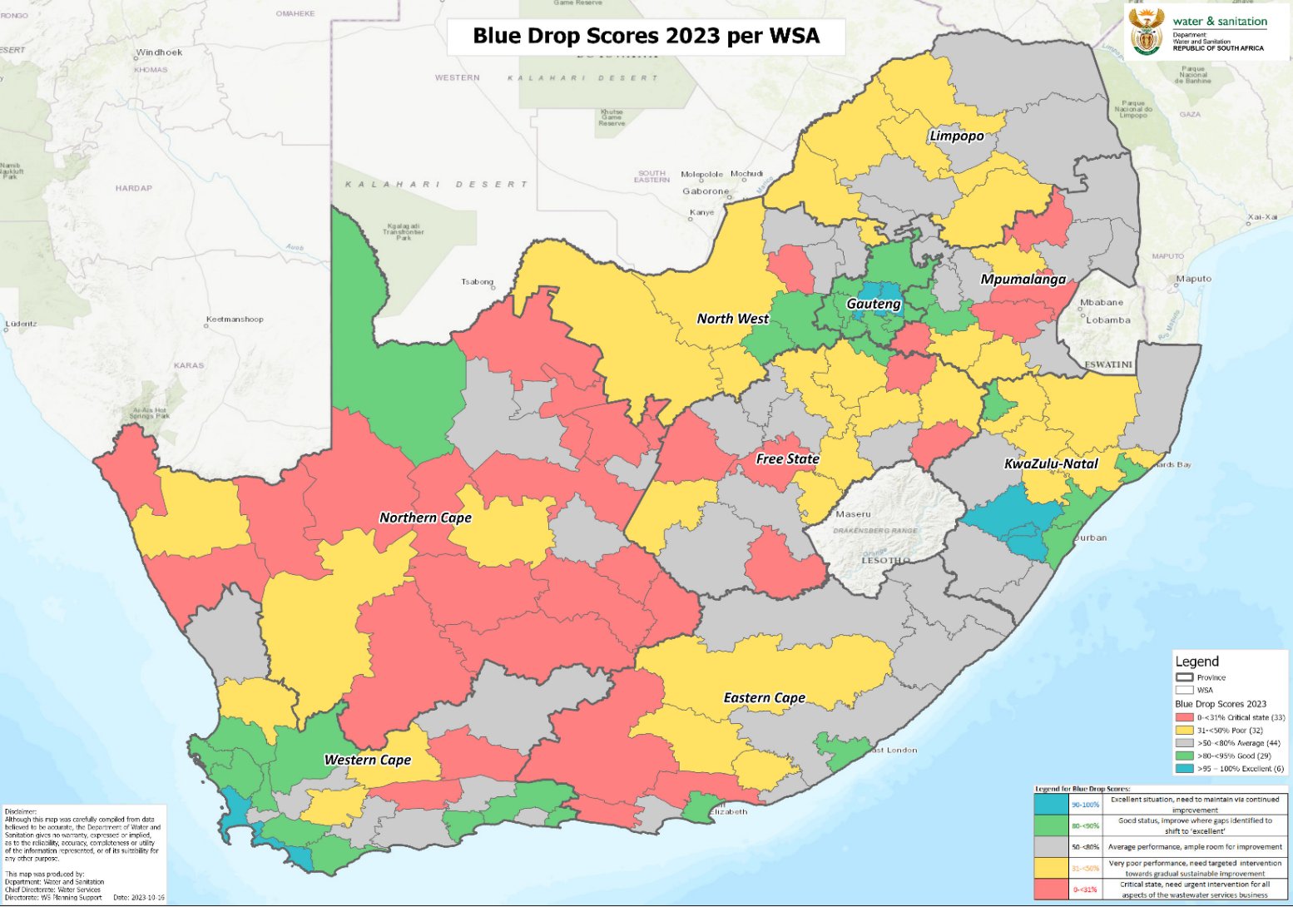
2023 Blue Drop scores: map
144 WSAs & 958 systems audited
7 Water Boards audited
26 Blue Drop Certifications
277 systems found to be in a critical state of performance
 | >95-100% | Excellent situation
 | >80-<95% | Good performance
 | >50-<80% | Average performance
 | >31-<50% | Very poor performance
 | 0-<31% | Critical state

Slide 19
2023 Blue Drop: findings regarding drinking water quality
  Based on water quality tests carried out by municipalities themselves during the 2021/2022 municipal financial year (2014 figures in brackets):
    54% of systems achieved excellent or good, 46% poor or bad microbiological water quality compliance (5% in 2014)
    76% of systems achieved excellent or good, 24% of systems unacceptable chemical water quality compliance (15% in 2014)
The overall performance trend indicates a severe regression from 2014 to 2023, especially with regard to microbiological compliance
Drinking water quality is generally good in the major metropolitan areas
During the audit period, 14 water service authorities (see Annexure B) did not report water quality data to the Department or provide any other evidence that they have been testing their water quality:
  The Department issued non-compliance notices to those municipalities instructing them to issue advisory notices to their residents that their water might not be safe to drink if it has not been properly tested
  DWS followed up with these WSAs and some of them indicated that they are in the process of appointing laboratories, others commenced with sampling, and others provided evidence of testing and achieving drinking water quality
  Where necessary these WSAs did issue advisory notices

Slide 20
2023 Blue Drop Drinking Water Quality: performance of water supply systems

Slide 21
Implications of 2023 Blue Drop drinking water quality findings
According to the South African Bureau of Standards (SANS 241 which is informed by World Health Organisation Guidelines), it is not safe to drink water if less than 97% of tests for microbiological contaminants and chemical compliance conducted over a year comply with water quality standards
It was therefore not microbiologically safe to drink the water in almost half (46%) of our drinking water systems at times during 2022 when the Blue Drop audit was done, which resulted in increased risk of life-threatening water-borne diseases such as cholera and chronic diarrhoea
The Blue Drop report does not provide an indication of the current status of water quality in municipalities
In terms of SANS241 and the norms and standards issued by DWS under the Water Services Act, when the tests carried out by a municipality indicate that the water supplied poses a health risk, the municipality must inform its consumers that the quality of the water that it supplies poses a health risk
DWS has sent non-compliance letters to the municipalities having systems with poor or bad compliance in the 2023 Blue Drop Report. These letters require the municipalities to inform their residents should they still have poor or bad compliance
The public can safely consume water from their taps if their municipalities indicate that the water being provided is being tested and meets the requirements of SANS 241 – residents should check with their municipalities if this is the case
The department provides monthly water quality data received from municipalities on its Integrated Regulatory Information System webpage that can be accessed at ws.dws.gov.za/iris/mywater.aspx

Slide 22
2023 Blue Drop: drinking water infrastructure condition
Of 151 systems (at least 1 per WSA and Water Board) physically assessed:
  3% of the sampled systems were found to be in a critical infrastructural condition, 12% in a poor infrastructural condition
  49% in an average infrastructural condition
  31% in good condition, and 5% in an excellent condition
  The fact that 85% of drinking water systems were in an average or better infrastructure condition indicates that non-infrastructure factors such as a lack of skilled staff or a lack of proper process controls are as important as infrastructure condition, if not more important, as contributors to poor performance
  The 2022 Green Drop report found municipal wastewater collection and treatment infrastructure to be in a worse condition (only 44% in an average or better infrastructure condition), indicating a reluctance of municipal councils to budget for maintenance of wastewater infrastructure in particular

Slide 23
2023 Blue Drop: technical competence
‘Technical competence’ assesses the technical human resources capacity that is available to manage and operate water treatment processes and maintain the related water infrastructure
Province | # WTWs | # WSSs | # Required Staff |  | # Available staff with required qualifications |  | Staff Shortfall
 |  |  | Process Controllers | Supervisors | Process Controllers | Supervisor | Process Controllers | Supervisors
EC | 222 | 154 | 700 | 276 | 293 | 265 | 407 (58%) | 11 (4%)
FS | 75 | 80 | 276 | 72 | 154 | 58 | 122 (44%) | 14 (19%)
GP | 19 | 29 | 154 | 42 | 128 | 42 | 26 (17%) | 0 (0%)
KZN | 190 | 172 | 615 | 154 | 294 | 143 | 321 (52%) | 11 (7%)
LP | 85 | 84 | 439 | 46 | 235 | 35 | 114 (26%) | 11 (24%)
MP | 107 | 100 | 451 | 165 | 319 | 143 | 132 (29%) | 12 (7%)
NC | 158 | 176 | 370 | 75 | 52 | 52 | 318 (86%) | 23 (30%)
NW | 33 | 39 | 110 | 33 | 79 | 29 | 31 (28%) | 4 (12%)
WC | 126 | 124 | 415 | 247 | 272 | 230 | 143 (34%) | 17 (7%)
Totals | 1,015 | 958 | 3530 | 1110 | 1,826 | 997 | 1,614 | 103
Gauteng has the highest percentage of drinking water systems with excellent or good performance and the lowest shortfall of qualified staff
Northern Cape has the highest percentage of drinking water systems with poor or critical performance and the highest shortfall of qualified staff

Slide 24
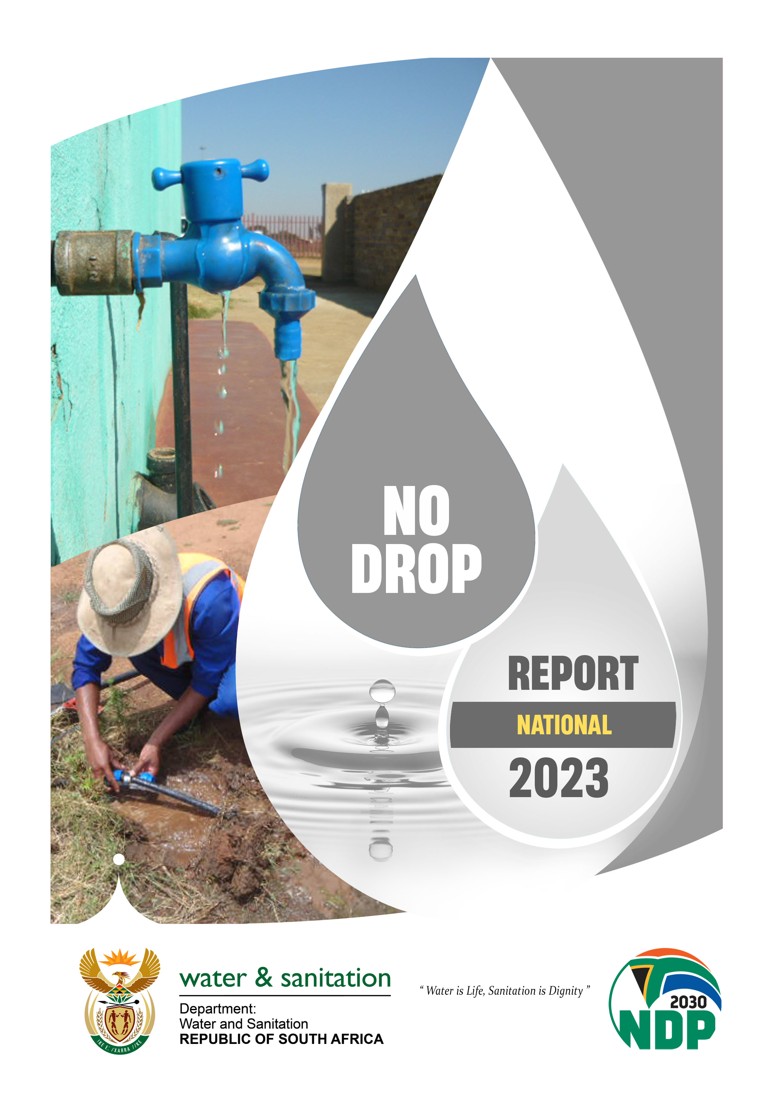
2023 No Drop Report
Audit year: 1 Jul 2021- 30 Jun 2022
The report is available for download from www.dws.gov.za

Slide 25
2023 No Drop: introduction
As indicated earlier, the No Drop Programme assesses the degree to which the drinking water distribution systems of municipalities supply water efficiently, without wasting water
No Drop assessment covers:
Levels of physical water losses in the system (for example through leaks in pipes)
Levels of non-revenue water
Amount of water used per capita per day
Whether infrastructure is being maintained properly to minimise wastage
Existence of plans and strategies to reduce water losses
Effectiveness of metering, billing and revenue collection systems
All 144 Water Services Authorities were audited during the period 1 July 2021- 30 June 2022
The Department trained the WSAs on the scope and the criteria for the audit cycle
WSAs provided information which was verified by the Department

Slide 26
2023 No Drop: terminology
Non-Revenue Water (NRW) is treated water that is bought or produced by the municipality for which the municipality gets no revenue
NRW is caused by:
  Physical losses e.g. water leaking out of pipes above or underground
  Poorly functioning or non-existent water meters
  Illegal connections
  Poor billing and revenue collection
Why is NRW a problem?
  A huge amount of money has to be spent to develop dams to capture and store water. This money is wasted if that water is thrown away through leaks
  Municipalities buy treated water from Water Boards. If municipalities do not get revenue from that water, then they cannot pay the Water Boards. If Water Boards don’t get paid, they can’t treat water anymore
  If municipalities don’t collect the revenue they are supposed to collect, then they cannot afford to maintain and operate the infrastructure
  South Africa is a water scarce country and every drop counts! We cannot afford to throw treated water away through leaks

Slide 27
2023 No Drop: summary of criteria
Criteria and Sub-Criteria | Weight/Sub-weight
Criteria 1: WC/WDM Strategy, Planning and Implementation | 45%
1.1 Water Resource Balance Diagram | 5 %
1.2 Water Balance | 20 %
1.3 WC/WDM Strategy, Business Plan and Implementation | 20 %
CRITERIA 2: ASSET MANAGEMENT | 10%
2.3 Consumer meter maintenance and replacement programme | 5-10%
2.5 Monitoring and analysis of, and response to high water loss supply zones | 0-5 % (Metro)
CRITERIA 3: TECHNICAL SKILLS | 10 %
3.1 Availability and Competence of the water loss manager and team | 10 %
CRITERIA 5: Compliance and Performance | 35%
5.1 Repair of Reticulation leaks | 5 %
5.2 Physical Losses | 30 %
5.3 Commercial Losses
5.4 Non-Revenue Water
5.5 Water Use Efficiency
BONUS | 10 %
1 a) Multi-year water balances | 10 %
PENALTY | 10 %
1 b) Inclusion of the WDM strategy in the IDP | 10 %

Slide 28
2023 No Drop: key findings
4 WSAs scored more than 90% and qualified for the prestigious No Drop Certification
In 2014, 44 WSAs were awarded No Drop status
  An overall decline in excellence is noted between 2014 and 2023
8 WSAs scored between 80 and <90%, which is good performance
64 WSAs scored below 30% (see Annexure C)
The total volume of water treated for municipal use is 4.4 billion m3/annum. Of this, 2.1 billion m3/annum (47%) is estimated to be non-revenue water (NRW)
NRW was 37% in the 2014 No Drop report
The international average for non-revenue water is 30%
The national trends suggest that average per capita water consumption is approximately 218 litres/capita/day compared to the international average of 173 l/c/d. This is an anomaly given that South Africa is a water scarce county
The high level of physical losses in municipal distribution systems is one of the main reasons for the relatively high level of per capita consumption in South Africa
Poor operation and maintenance of infrastructure leads to unacceptably high physical losses
In order to reduce non-revenue water, municipalities need to improve operation and maintenance of their infrastructure; repair leaks; improve metering, billing, revenue collection, and debtor management; improve pressure management; and engage in community education and awareness; amongst other measures

Slide 29
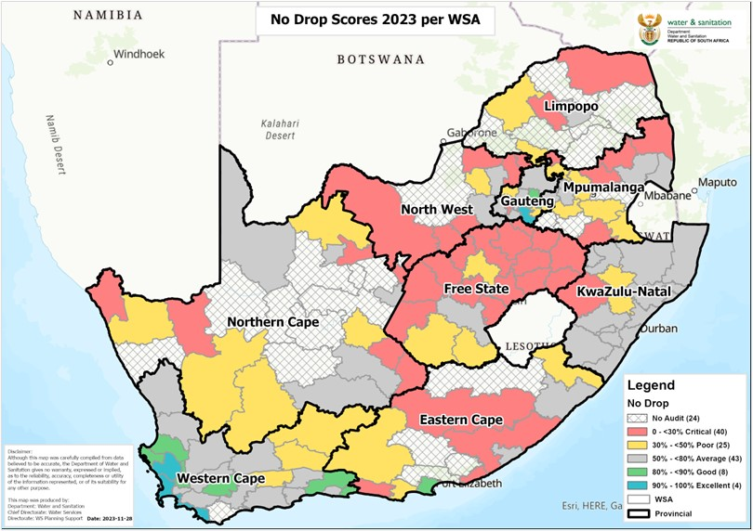
2023 No Drop: map
144 WSAs audited
4 No Drop Certifications
64 critical state WSAs
 | >90-100% | Excellent situation
 | >80-<90% | Good performance
 | >50-<80% | Average performance
 | >30-<50% | Poor performance
 | 0-<30% | Critical state

Slide 30
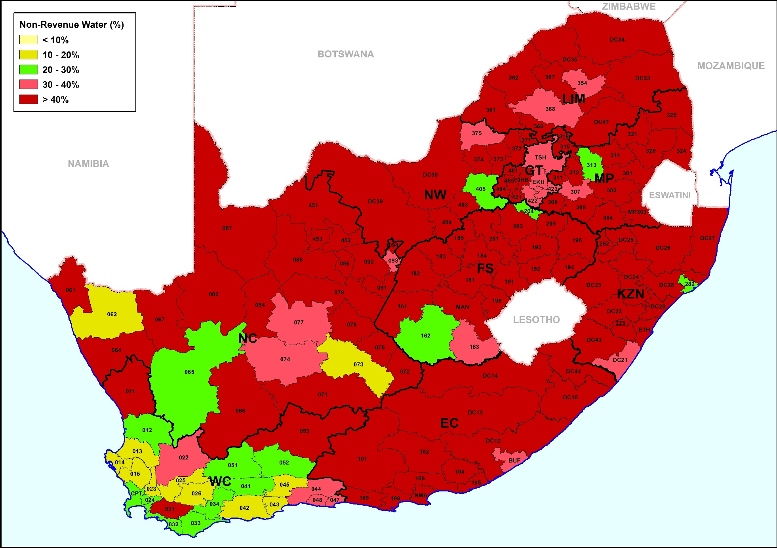
2023 No Drop: percentage NRW per WSA
Province | % NRW
EC | 50.6
FS | 59.5
GP | 49.2
KZN | 60.5
MP | 54.9
LP | 57.7
NC | 49.0
NW | 55.6
WC | 27.6
National | 47.4
The high levels of NRW, including physical losses, in GP and KZN are one of the reasons for water supply disruptions that have been experienced there

Slide 31
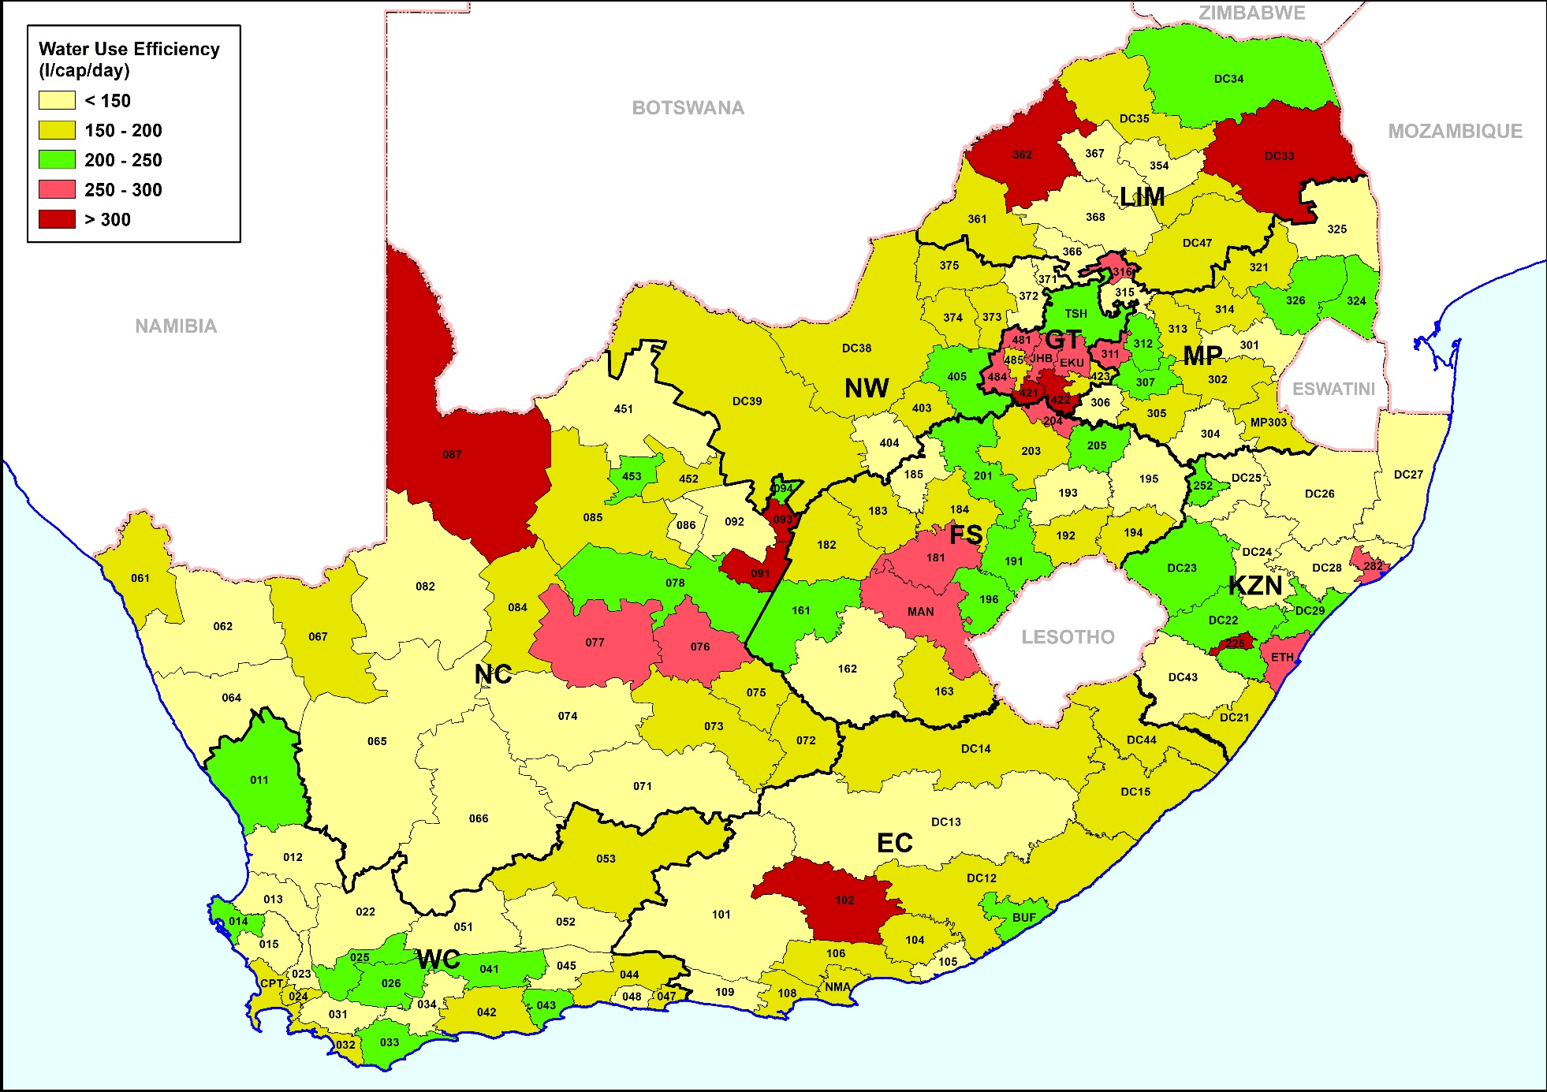
2023 No Drop: average litres per capita per day (l/c/d) water consumption per WSA
Province | l/c/d
EC | 180
FS | 196
GP | 279
KZN | 187
MP | 179
LP | 197
NC | 193
NW | 167
WC | 164
National | 218
The high level of consumption in Gauteng is one of the reasons why the demand for treated water in Gauteng is occasionally exceeding the available supply
The low NRW and low average level of consumption in Western Cape may be partly a result of the effective water conservation and demand management programme implemented by the City of Cape Town to avoid Day Zero

Slide 32
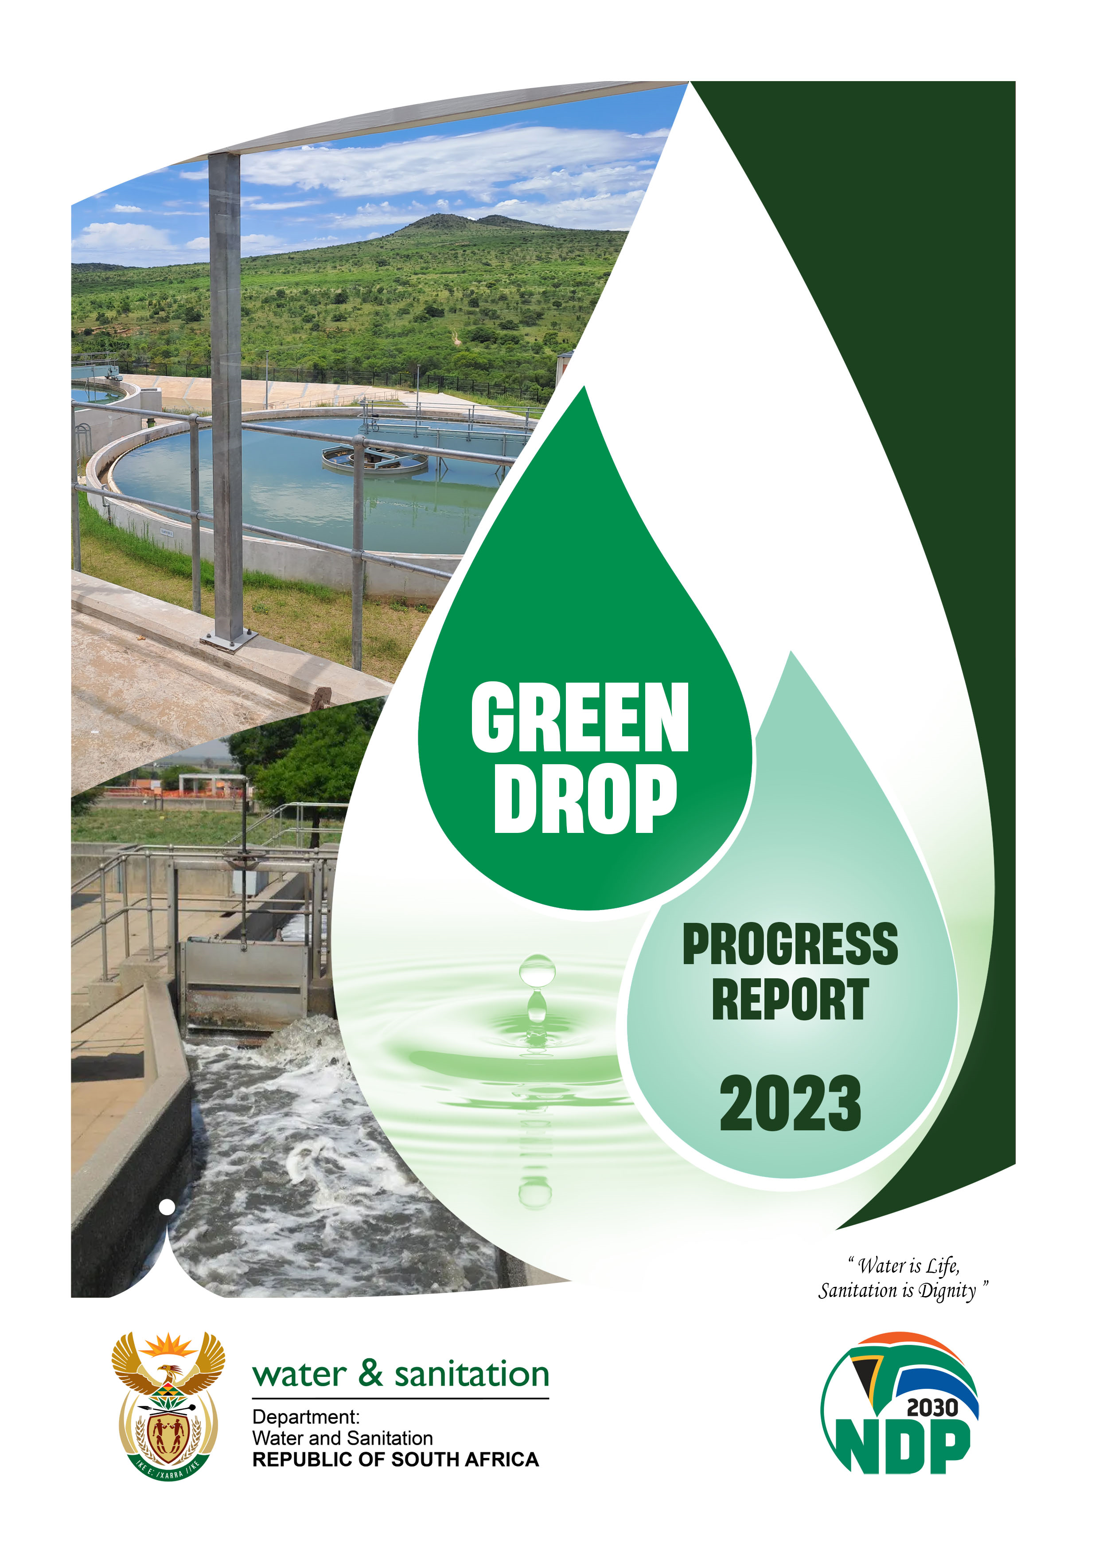
2023 Green Drop Progress Assessment Report
Audit year: 1 Jul 2021- 30 Jun 2022
The Report is available for download from www.dws.gov.za
32

Slide 33
2023 Green Drop: introduction
As indicated earlier, the Green Drop Progress Report focuses on wastewater treatment works (WWTWs) (the full Green Drop report, released in 2022 is more comprehensive and covers the sewer collection networks and pumpstations as well as the wastewater treatment works)
The progress assessment report covers WWTW in:
  144 Water Services Authorities (867 WWTWs)
  The Department of Public Works (107 WWTWs)
  Eskom, Nedbank, Sasol and San Parks (29 WWTWs)
Each WWTW was assessed in terms of:
  Whether the plant has the capacity to process the amount of sewage going into it
  Whether the WWTW have the required staff with the necessary qualifications and experience to properly operate and maintain the plants
  Whether the plants meet the statutory requirements for the quality of the effluent coming out of the plants
Each WWTW was categorised in terms of the risk that it poses, in terms of the risk of putting partially treated or untreated wastewater into the environment

Slide 34
2023 Green Drop: findings
Results:
9% of WWTWs are in the low-risk category
25% of WWTWs are in the medium-risk category
34% of WWTWs are in the high-risk category, and
32% of WWTWs are in the critical-risk category
WWTWs in the high risk or critical risk category are resulting in high levels of pollution through discharging partially treated or untreated water into rivers and the environment
This has negative environmental implications and poses risks to human health, e.g. cholera outbreaks are normally associated with wastewater pollution of water resources
Polluted water resources also raise the cost of water treatment
The number of WWTWs in the high- and critical-risk categories have both increased since 2013

Slide 35
2023 Green Drop: graphic

Slide 36
2023 Green Drop: findings by province
  The report provides an average wastewater treatment risk rating per province, based on the risk ratings for WWTWs in that province
  None of the provinces have improved their WWTWs risk ratings since 2022
  The provincial risk ratings for WWTWs in Gauteng, KwaZulu-Natal and Western Cape have remained in the medium-risk category since 2022
  The performance of WWTWs in the Northern Cape worsened from high-risk to critical-risk rating between 2022 and 2023. 22% (18/81) of WWTWs in the Northern Cape are in the high-risk category and 74% (60/81) of WWTWs are in the critical-risk category
  All other provinces have remained in the high-risk category since 2022

Slide 37

2023 Green Drop: findings by province graphic
2022 (left bar) and 2023 (right bar)

Slide 38
What government is doing to address the Drop results

Slide 39
Underlying causes of poor performance in terms of Drop reports
Non-adherence to standard operating processes for drinking water treatment and wastewater treatment
Infrastructure in a poor condition due to a lack of maintenance
Causes:
  Municipalities not hiring the necessary staff with the correct qualifications
  Non-prioritization of budgets for maintenance and operations by municipal councils
  Weak billing and revenue collection
  Poor municipal leadership and management
There is no legal requirement for municipalities to use revenues from the sale of water and from sanitation charges to fund the maintenance and operation of water and sanitation infrastructure
Vandalism and metal theft of infrastructure are an increasing cause of infrastructure failure, but this is partly a result of inadequate security being provided by municipalities

Slide 40
Support to municipalities
WSAs with water or wastewater systems in a critical state are required to submit detailed corrective action plans to DWS, and are offered support to produce these plans
DWS Minister and Deputy Ministers spend most of their time crisscrossing the country visiting those municipalities with severe challenges with water and sanitation services
DWS and Water Boards are supporting many of the municipalities to implement improvement plans agreed to by Ministry and municipal leadership
DWS works with COGTA, the Municipal Infrastructure Support Agency, the Department of Human Settlements, and National Treasury to provide support to the worst performing municipalities, including:
  Allocating infrastructure grants worth more than R20 billion per annum to municipalities
  Technical and engineering support and assistance
  Capacity building and training
  Financial management advice and support

Slide 41
Limits to impact of support to municipalities
Despite all the support being provided to municipalities, the drop reports indicate that water services continue to decline
There are limitations to which national support programmes can turn around the decline:
  In those cases where the leadership of the municipality is not responding to directives or not listening to advice or not accepting support, performance can only be improved by addressing the leadership challenges
  The main cause of the decline in water services is poor maintenance and operation by municipalities – which must be funded by revenue from the sale of water by municipalities to customers
  DWS and COGTA are repeatedly providing municipalities with grants to repair infrastructure, which is not maintained by the municipalities, deteriorates again rapidly, and then funding needs to be provided again
  National government cannot make decisions to prioritise maintenance and operation funding on behalf of municipalities – these decisions must be made by municipal Councils
  National government cannot hire staff on behalf of municipalities – the municipal leadership must prioritise the filling of key technical positions with appropriately skilled staff and budget for this from revenue
Fundamental reform is required to arrest and turn around the decline in municipal water and sanitation services

Slide 42
Strengthening regulation of water services
DWS will soon issue updated and more comprehensive national norms and standards for water and sanitation services
DWS will also publish a National Regulatory Dashboard showing compliance with national norms and standards
DWS has gazetted the Water Services Amendment Bill for public comment
Water Services Act distinguishes between roles of Water Services Authority (WSA) and Water Services Provider (WSP) in municipalities
  WSA is the part of the municipality that is responsible for ensuring that water services are provided according to national norms and standards (the local regulator)
  WSP is the part of the municipality which is responsible for providing the service
Bill introduces a compulsory operating license system for WSPs, to be managed by DWS as the national regulator
This will enable WSAs to ensure that WSPs have minimum competency, capability, and performance levels
Bill empowers Minister to instruct a WSA to appoint a Water Services Provider that is licensed
Bill clarifies functions of WSAs and WSPs, including that billing and revenue collection for water is a WSP function
Bill provides for Minister to implement regulatory enforcement protocols (non-compliance notices, directives) for water services, and to make gross non-compliance an offence, similarly to National Water Act

Slide 43
Thank You!
43

Slide 44
Annexure A:
List of water service authorities and their water supply systems in a critical state of performance per province

Slide 45
National BD Score (<31% Critical State) Summary
WSA Name | 2023 Critical State (<31%)
Eastern Cape (5 WSA 27 WSS) | Water Supply Systems
Alfred Nzo DM | Kinira
Chris Hani DM | Farms & Rural, Hofmeyer and Tarkastad
Dr Beyers Naude LM | Aberdeen, Graaff-Reinet, Jansenville, Klipplaat, Nieu-Bethesda, Rietbron, Steytlerville, WaterFord, Willowmore and Wolwefontein
Koukamma LM | Blikkiesdorp, Clarkson, Coldstream, Joubetina, Kareedouw, Krakeel, Louterwater, Misgund, Sanddrif, Storms River and Woodlands
Sundays River Valley LM | Addo and Kirkwood
WSA Name | 2023 Critical State (<31%)
Free State (10 WSA 31 WSS) | Water Supply Systems
Mafube LM | Frankfort, Tweeling, Villiers
Maluti-a-Phofung LM | Bluegumbosch, Kestell, Harankopane, Mphatlalatsane, Greater Qwaqwa, Makwane, Harrismith, Tshiame
Mangaung | Soutpan Krugersdrift Dam
Mantsopa LM | Hobhouse, Tweespruit
Masilonyana LM | Brandfort, Theunissen, Verkeerdevlei, Winburg
Mohokare LM | Rouxville, Smithfield, Zastron
Moqhaka LM | Steynsrus
Ngwathe LM | Parys, Vredefort, Koppies, Edenville boreholes
Setsoto LM | Clocolan, Senekal
Tokologo LM | Boshof, Dealesville

Slide 46
National BD Score (<31% Critical State) Summary
WSA Name | 2023 Critical State (<31%)
KwaZulu Natal (4 WSA 21 WSS) | Water Supply Systems
Harry Gwala DM | Machunwini, Chibini
King Cetshwayo DM | Khombe, Pikiliyeza
Umzinyathi DM | 12 of 13 WSSs
Zululand DM | Coronation, eMondlo, Hlobane, Louwsberg, Vryheid
Limpopo (6 WSA 26 WSS) | Water Supply Systems
Bela-Bela LM | Radium, Rapotokwane
Capricorn DM | Alldays, Botlokwa, Mogwadi and Senwabarwana
Greater Sekhukhune DM | Flag Boshielo, Kutullo, Magukubjane, Mahlokoena, Mapodile, Marishane, Masemola, Ngwaabe, Nkosini, Penge, Steelpoort, Tsakane and Vergelegen
Modimolle/Mookgophong LM | Mookgophong, Mabaleng, Mabatlane and Roedtan
Mopani DM | Drakensig
Thabazimbi LM | Leeupoort and Rooiberg
WSA Name | 2023 Critical State (<31%)
Mpumalanga (8 WSA 34 WSS) | Water Supply Systems
Albert Luthuli LM | All 8 WSSs
Dipaleseng LM | Greater Dipaleseng
Emakhazeni LM | Belfast, Dullstroom
Mbombela/Umjindi | Elandshoek, Hazyview, White River, White River Country & Golf Estates, Mjindini Trust-Madakwa, Rimers-Suid Kaap, Sheba, Mjejane, Legogote, Nyongane River, Dwaleni, Mshadza
Mkhondo LM | Rural WSS
Msukaligwa LM | Breyten, Davel, Douglas dam, Lothair, South works (noitgedacht farm)
Thaba Chweu LM | Coromandel, Graskop, Lydenburg, Sabie
Thembisile LM | Langkloof

Slide 47
National BD Score (<31% Critical State) Summary
WSA Name | 2023 Critical State (<31%)
Northern Cape (22 WSA 123 WSS) | Water Supply Systems
!Kai! Garib LM | All 16 WSSs
!Kheis LM | Gariep, Grootdrink, Wegdraai
Dikgatlong LM | Barkley West, Windsorton
Emthanjeni LM | All 3 WSSs
Gamagara LM | Dibeng
Ga-Segonyana LM | 23 of 24 WSSs
Joe Morolong LM | 17 of 18 WSSs
Kamiesberg LM | All 16 WSSs
Kareeberg LM | All 3 WSSs
Karoo Hoogland LM | All 3 WSSs
Kgatelopele LM | Danielskuil
Khai-Ma LM | All 4 WSSs
Magareng LM | Warrenton
Nama Khoi LM | Buffelsrivier, Carolusberg, Goodhouse, Kommagas, Rooiwal, Vioolsdrift
Phokwane LM | Hartswater, Jan Kempdorp
WSA Name | 2023 Critical State (<31%)
Renosterberg LM | All 3 WSSs
Richtersveld LM | All 5 WSSs
Siyancuma LM | All 4 WSSs
Siyathemba LM | Marydale
Tsantsabane LM | Skeyfontein
Ubuntu LM | All 5 WSSs
Umsobomvu LM | All 3 WSSs

Slide 48
National BD Score (<31% Critical State) Summary
WSA Name | 2023 Critical State (<31%)
North West (3 WSA 7 WSS) | Water Supply Systems
Dr. Ruth S Mompati DM | Bogosing, Majeakgoro, Pudimoe, Schweizer Reneke
Kgetlengrivier LM | Koster, Swartruggens
Ngaka Modiri Molema DM | Ratlou: Kraaipan Cluster B/H
WSA Name | 2023 Critical State (<31%)
Western Cape (4WSA 8 WSS) | Water Supply Systems
Beaufort West LM | Murraysburg, Nelspoort
Hessequa LM | Jongensfontein
Kannaland LM | Ladismith, Van Wyksdorp, Zoar
Prince Albert LM | Klaarstroom, Prince Albert

Slide 49
Annexure B:
List of water service authorities that failed to provide microbiological water quality information for the Blue Drop audit period

Slide 50
Water Service Authorities (WSAs) that failed to provide microbiological water quality information for the BD audit period
Name of WSA | Name of Water Supply System | Name of WSA | Name of Water Supply System
Kou-Kamma LM (EC) | Joubertina, Krakeel Louterwater Misgund | Maluti a Phofung LM (FS) | Bluegumbosch Supply system Greater QWAQWA Supply System HaRankopane Supply System Harrismith water Supply System Kestell Supply system Makwane water supply system Mphatlalatsane Supply System Tshiame Water Supply System
Mafube LM (FS) | Frankfort Tweeling Villiers
Ngwathe LM (FS) | Edenville Boreholes Koppies Supply System Parys Vredefort supply system

Slide 51
Water Service Authorities (WSAs) that failed to provide microbiological water quality information for the BD audit period
Name of WSA | Name of Water Supply System | Name of WSA | Name of Water Supply System
Modimolle/Mookgopong Local Municipality (L) | Mookgophong Supply System Roedtan borehole System LIM365:Mabaleng Res(Borehole MM 006/2010) LIM365:Mabatlane Res (Borehole MM 007/2010) | Thaba Chweu Local Municipality (Mpu) | Coromandel Water Treatment Plant Graskop Water Supply System Lydenburg Water Treatment Plant Sabie Water Supply System
Thabazimbi Local Municipality (L) | Rooiberg Water Scheme Leeupoort Water Scheme | Khai-Ma Local Municipality (NC) | Onseepkans (Melkbosrand TW) System Onseepkans (RK) System Witbank System
Dipaleseng Local Municipality (Mpu) | Fortuna. | Renosterberg Local Municipality (NC) | Petrusville (from Vanderkloof) System Phillipstown Boreholes System Vanderkloof System
Mbombela/Umjindi Local Municipality (Mpu) | White River Country Estates (White River CE TW)

Slide 52
Water Service Authorities (WSAs) that failed to provide microbiological water quality information for the BD audit period
Name of WSA | Name of Water Supply System | Name of Water Supply System | Name of Water Supply System
Joe Morolong Local Municipality | Bothetheletsa Groundwater Management Area: D41L-M2 System | Heiso Groundwater Management Area: D41L-M8 System | Metsetswaneng Groundwater Management Area: D41L-M7 System
 | Bothithong Groundwater Management Area D41G-04 System | Kikahela Groundwater Management Area: D41L-M1 System | Tsineng Groundwater Management Area: D41L-M11 System
 | Churchill Groundwater Management Area: D41L-M10 System | Laxey Groundwater Management Area D41G-05 System | Van Zylsrus (Boreholes) System
 |  |  | Ward 1 Heuningvlei
 | Dithakong Groundwater Management Area D41G-02 System | Maipeng Groundwater Management Area D41L-K9 System | Manyeding A Groundwater Management Area: D41L-M5 System
 | Gasehunelo Groundwater Management Area: D41L-M9 System | Mamatwan/Hotazel Ground water Management Area D41K-G2 System | Gasese Groundwater Management Area D41L-K10 System

Slide 53
Water Service Authorities (WSAs) that failed to provide microbiological water quality information for the BD audit period
Name of WSA | Name of Water Supply System | Name of WSA | Name of Water Supply System
Kamiesberg Local Municipality (NC) | Garies System | Kamiesberg Local Municipality (continued) | Soebatsfontein System
 | Hondeklipbaai System |  | Spoegrivier System
 | Kamassies System |  | Tweerivier System
 | Garies System | Dr. Ruth S Mompati District Municipality (NW) | Schweizer Reneke System
 | Kharkams System
 | Kheis System
 | Klipfontein System
 | Koiingnaas System
 | Leliefontein System
 | Lepelfontein System
 | Nourivier System
 | Paulshoek System
 | Rooifontein

Slide 54
Annexure C:
No Drop
List of Water Service authorities and their critical systems per province

Slide 55
National ND Score (<31% Critical State) Summary
Name of the WSA | No Drop Score (%) | Name of the WSA | No Drop Score (%)
Kou-Kamma LM (EC) | 11 | Thaba Chweu (MP) | 19
Ndlambe (EC) | 26 | Pixley ka Seme (MP) | 17
Chris Hani DM (EC) | 20 | Emakhazeni (MP) | 5
Amathole DM (EC) | 4 | Dr J S Moroka (MP) | 20
City of Matlosana(NW) | 1 | Bushbuckridge (MP) | 15
Moretele LM (NW) | 0 | Rand West City (GP) | 0
Maquassi Hills LM (NW) | 16 | Uthukela DM (KZN) | 22
Madibeng LM (NW) | 5 | Vhembe DM (LP) | 0
Dr Ruth Segomotsi Mompati DM (NW) | 26 | Mogalakwena (LP) | 2
Moses Kotane (NW) | 10

Slide 56
National ND Score (<31% Critical State) Summary
Name of the WSA | No Drop Score (%) | Name of the WSA | No Drop Score (%)
Umsobomvu (NC) | 0 | Nala (FS) | 20
Renosterberg (NC) | 4 | Moqhaka (FS) | 6
Khai-Ma (NC) | 5 | Metsimaholo (FS) | 13
Ga-Segonyana (NC) | 23 | Masilonyana (FS) | 0
Magareng (NC) | 10 | Mantsopa (FS) | 11
Richtersveld (NC) | 12 | Maluti a Phofung (FS) | 26
Tswelopele (FS) | 4 | Mafube (FS) | 16
Tokologo (FS) | 4 | Letsemeng (FS) | 16
Setsoto (FS) | 1 | Dihlabeng (FS) | 6
Phumelela (FS) | 2
Nketoana (FS) | 4
Ngwathe (FS) | 0

Slide 57
National ND Score (0% Critical State) Summary
Name of WSA | No Drop Score (%) | Name of WSA | No Drop Score (%)
!Kheis | 0% (NI) | Lekwa | 0% (NI)
Blue Crane Route | 0% (NI) | Makana | 0% (NI)
Cape Agulhas | 0% (NI) | Modimolle | 0% (NI)
Capricorn DM | 0% (NI) | Mopane DM | 0% (NI)
Chief Albert Luthuli | 0% (NI) | Ngaka Modiri Molema DM | 0% (NI)
Dikgatlong | 0% (NI) | Phokwane | 0% (NI)
Dipaleseng | 0% (NI) | Sekhukhune DM | 0% (NI)
Joe Gqabi DM | 0% (NI) | Siyancuma | 0% (NI)
Kai !Garib | 0% (NI) | Siyathemba | 0% (NI)
Kamiesberg | 0% (NI) | Sunday’s River Valley | 0% (NI)
Kareeberg | 0% (NI) | Thabazimbi | 0% (NI)
Kgatelopele | 0% (NI) | Tsantsabane | 0% (NI)
NI =No Information Provided during audit

